Slide 1

GIS Level 1: Introduction to GIS & Mapping
1
Courtesy of US Air Force. Image is in the public domain.

Slide 2
Outline
Introduction – What is GIS?
Software options
Applications
Understanding Maps & Data
Data Layers
Spatial Data Types
Characteristics of Spatial Data
Metadata
Making Great Maps – Data Visualization Principles
2

Slide 3
Introduction
3

Slide 4
Geographic Information System
“A system for
capturing, storing, checking, integrating, manipulating, analyzing and displaying
spatial data”
4
Notes:
GIS stands for geographic information system but what does that really mean?
A GIS system can do a lot of things.

Slide 5
Geographic Information System
“A system for
capturing, storing, checking, integrating, manipulating, analyzing and displaying
spatial data”
5
Notes:
The most important thing to know is that a GIS is a system works with spatial data.

Slide 6
Input: spatial data
GIS/Mapping Software: analysis and data visualization
Does not come with its own data
Output: new data and maps
6
Notes:
GIS software works upon the data you provide it.
Just like other software, such as Excel or Word, you need to input data and can then use the software to display and analyze that data.

Slide 7
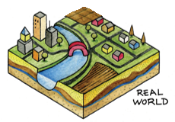
Theoretical Overview
GIS recreates real world spatial data
as digitized themed data “layers” (e.g. boundaries, socioeconomic, hydrology, infrastructure, transportation, land use/cover)
assembled in any combination
and overlaid for analysis
Image © source unknown. All rights reserved. This content is excluded from our Creative Commons license. For more information, see https://ocw.mit.edu/help/faq-fair-use/
7
Notes:
GIS software recreates or reproduces the real world as spatial data.

Slide 8
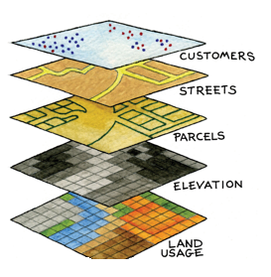
Theoretical Overview
GIS recreates real world spatial data
as digitized themed data “layers” (e.g. locations, boundaries, infrastructure, socioeconomic hydrology, land use/cover)
assembled in any combination
and overlaid for analysis
Image © source unknown. All rights reserved. This content is excluded from our Creative Commons license. For more information, see https://ocw.mit.edu/help/faq-fair-use/
8
Notes:
More specifically, the spatial data is broken down into themed data “layers” such as locations, boundaries of various kinds, socioeconomic variables, hydrology, and land use/cover.

Slide 9
Theoretical Overview
GIS recreates real world spatial data
as digitized themed data “layers” (e.g. locations, boundaries, infrastructure, socioeconomic hydrology, land use/cover)
assembled in any combination
and overlaid for analysis
Image © source unknown. All rights reserved. This content is excluded from our Creative Commons license. For more information, see https://ocw.mit.edu/help/faq-fair-use/
9
Notes:
These data layers can be assembled in any combination you want, depending on what you want to highlight.

Slide 10
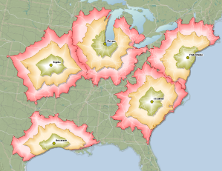
Theoretical Overview
GIS recreates real world spatial data
as digitized themed data “layers” (e.g. locations, boundaries, infrastructure, socioeconomic hydrology, land use/cover)
assembled in any combination
and overlaid for analysis
Image © source unknown. All rights reserved. This content is excluded from our Creative Commons license. For more information, see https://ocw.mit.edu/help/faq-fair-use/
10
Notes:
Power of GIS is in the ability to detect trends and make quantified decisions that would have otherwise been difficult just by hand or eye.
Once they have been overlaid in a particular combination, you can then conduct analyses.

Slide 11
SOFTWARE
11

Slide 12
Types of GIS & Mapping Software
Type | Analysis Power | Example(s)
Geobrowser | Weak (mainly only to display data) | Google Maps, Google Earth, Apple Maps, Waze, etc.
Web-based | Medium (able to upload additional data, customize display, and perform basic analyses) | Carto, ArcGIS Online, Mapbox, Google MyMaps, etc.
Desktop | Strong (installed locally, provides full control of map creation, and perform advanced analyses) | ArcGIS Pro QGIS
12
Notes:
The software you choose depends on what you will be doing with the data (displaying it vs. creating a new map vs. conducting analysis), the size of the data (large datasets require storage), and your audience (is it best to present the map on paper? Online? Do people need to interact with it?).
There are three types of software with very different capabilities.
1. Geobrowsers like Google Maps and Apple Maps are generally only useful for displaying data.
2. Web based tools like Carto, ArcGIS Online, and Mapbox, allow you to upload data, customize displays and perform basic analyses. Carto is licensed for MIT use and is free to use while you are at MIT but charges a fee otherwise. ArcGIS Online has both a free, public version and a paid version with additional features that MIT affiliates can access.
-Web-based software is the best way to add interactive elements. If you have programming skills you can use tools like Leaflet or OpenLayers to create online maps. Otherwise ArcGIS Online is easy to use and customize. Find out more about getting and account: https://libguides.mit.edu/gis/webmap
Learn more about using ArcGIS Online: https://doc.arcgis.com/en/arcgis-online/create-maps/create-maps-and-apps.htm
3. Desktop software, which are installed locally, provide the fullest suite of GIS tools for basic and advanced analyses and map creation. You will get hands on experience for each type of GIS in this presentation series.

Slide 13
Which desktop software should you use today?
ArcGIS Pro (by ESRI)
QGIS
Commercial software (expensive to purchase)
Only runs on Windows
Larger program – can run slowly on some computers
Full set of GIS functions and tools
Integration with ArcGIS Online
Fully developed training program (online modules, written tutorials, MOOCs)
Comprehensive support (direct support from ESRI, documentation for every tool)
Free, open-source tool
Runs on any operating system
Smaller program that will not affect performance of your computer
Many available tools, but lacking some for specific functions, such as network analysis (i.e. routing) and spatial statistics
Basic tutorials by QGIS developers and users
Tools can be developed by anyone so performance and documentation is inconsistent.
Support via forums
13
Notes:
Arcgis Pro is a more complete set of GIS tools but is license software and you may not have access to it beyond MIT. QGIS is free and open source but is a more limited set of GIS tools.
Along with the comprehensive support from Esri for Arcgis Pro, there is complete documentation for all ArcGIS Pro tools. In QGIS tools are made by many people with varying resources. Because of this there performance and documentation across tools is inconsistent.
Arcgis Pro only runs on Windows while Qgis runs on Windows, Apple, and Linux machines.
Both interfaces are similar so after you learn one software, it is fairly easy to use the other
For most uses, either software will work well so you may want to base your decision on your computer’s resources, how frequently you will need to use it, what you want to do, and the industry you plan to work in (or are currently working in). ESRI products are frequently used in educational settings, municipal governments, and large businesses and organizations. Because of cost considerations, QGIS may be used in small businesses and non-profits.

Slide 14
GIS Applications
14
Notes:
Now let’s discuss some applications you can do with a GIS.

Slide 15
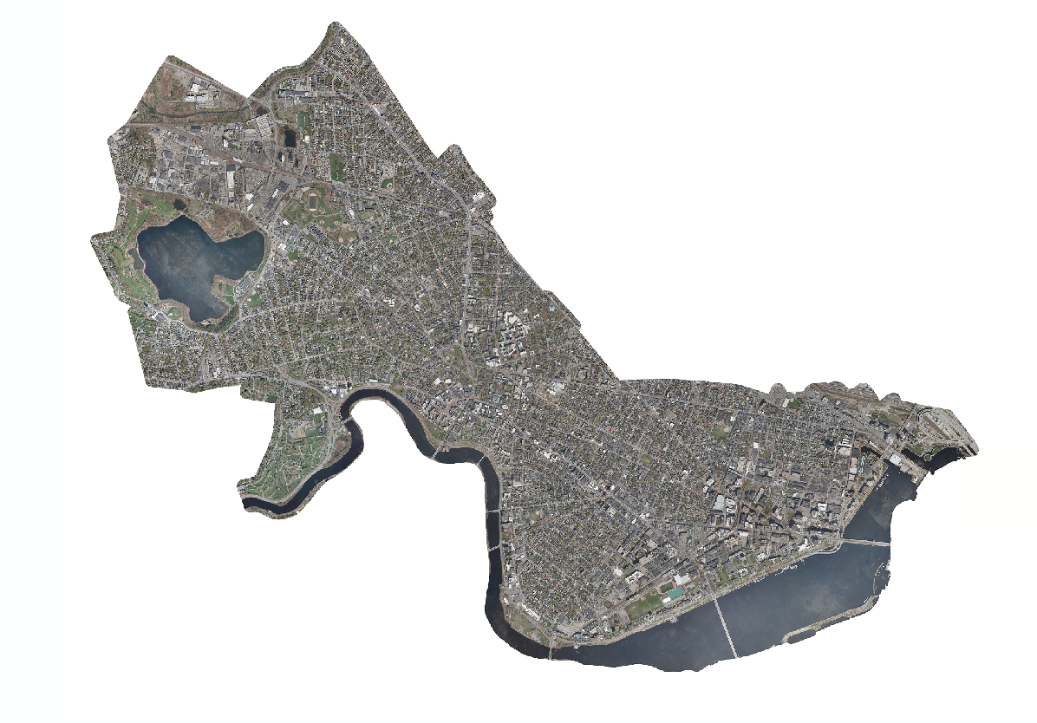
View Imagery
Check out our workshops on Remote Sensing & Imagery
City of Cambridge Aerial Photograph, April 2010
Image © source unknown. All rights reserved. This content is excluded from our Creative Commons license. For more information, see https://ocw.mit.edu/help/faq-fair-use/
15
Notes:
Many people use a GIS to look at satellite imagery or have it as a background to their maps.
-materials from our remote sensing workshops are on our guide: libguides.mit.edu

Slide 16
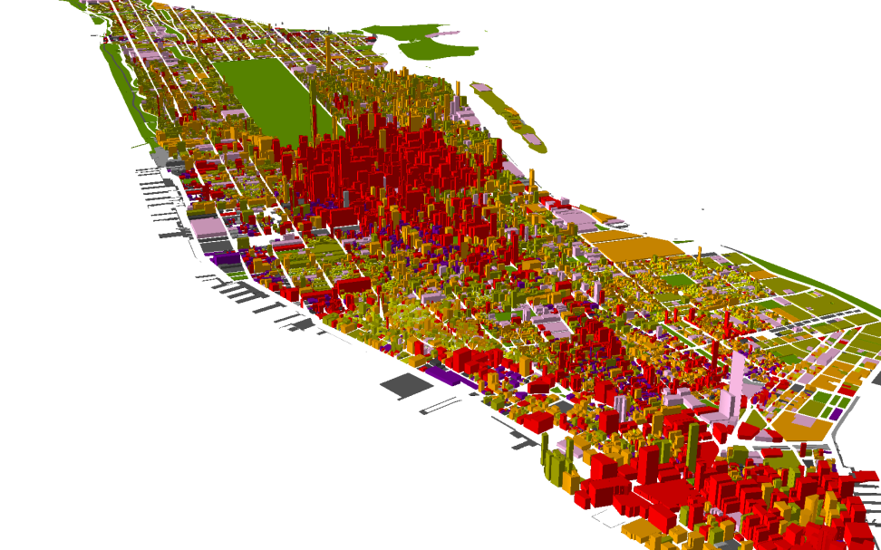
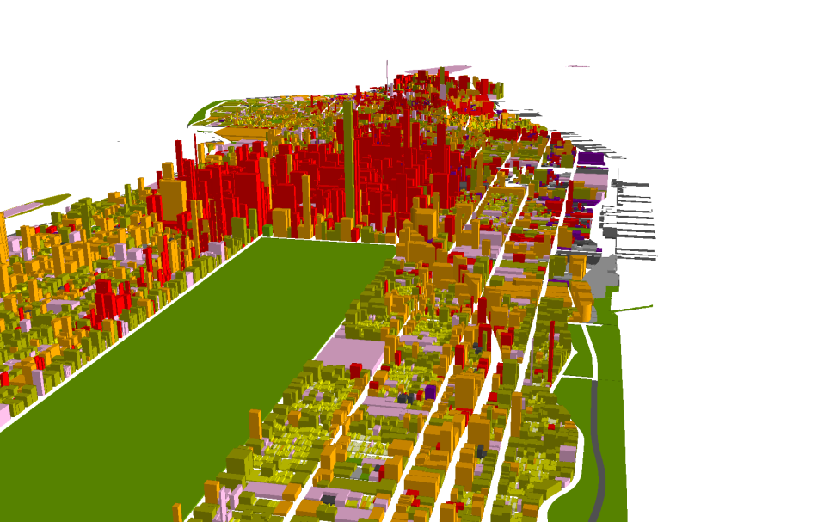
Create 3D models
We have additional 3D software: AutoCAD, Rhino, PhotoScan, etc.
16
Notes:
You can also make custom visualizations.
In this example, buildings in New York City have been color coded by land use and extruded vertically to represent height.
It is also possible to create animations over time and record videos flying through your map in a GIS.

Slide 17
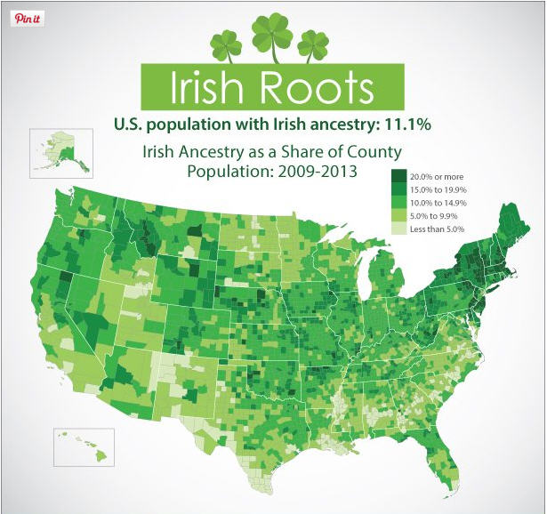
Create Maps
Maps combine art & science
Courtesy of US Census. Image is in the public domain.
17
Notes:
Maps also are used to share information, where design plays an important (even persuasive) role.
See how the creator chose green for Irish ancestry, and a darker shade of green for higher percentage

Slide 18
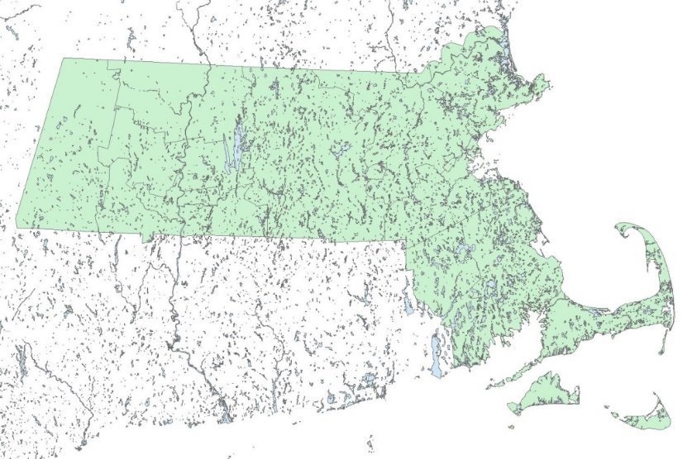
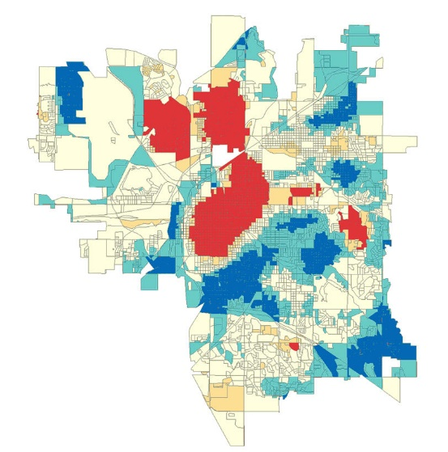
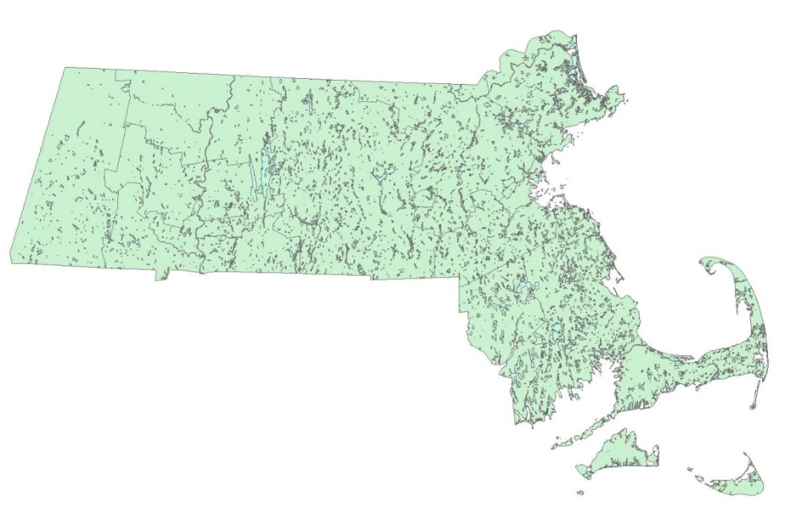
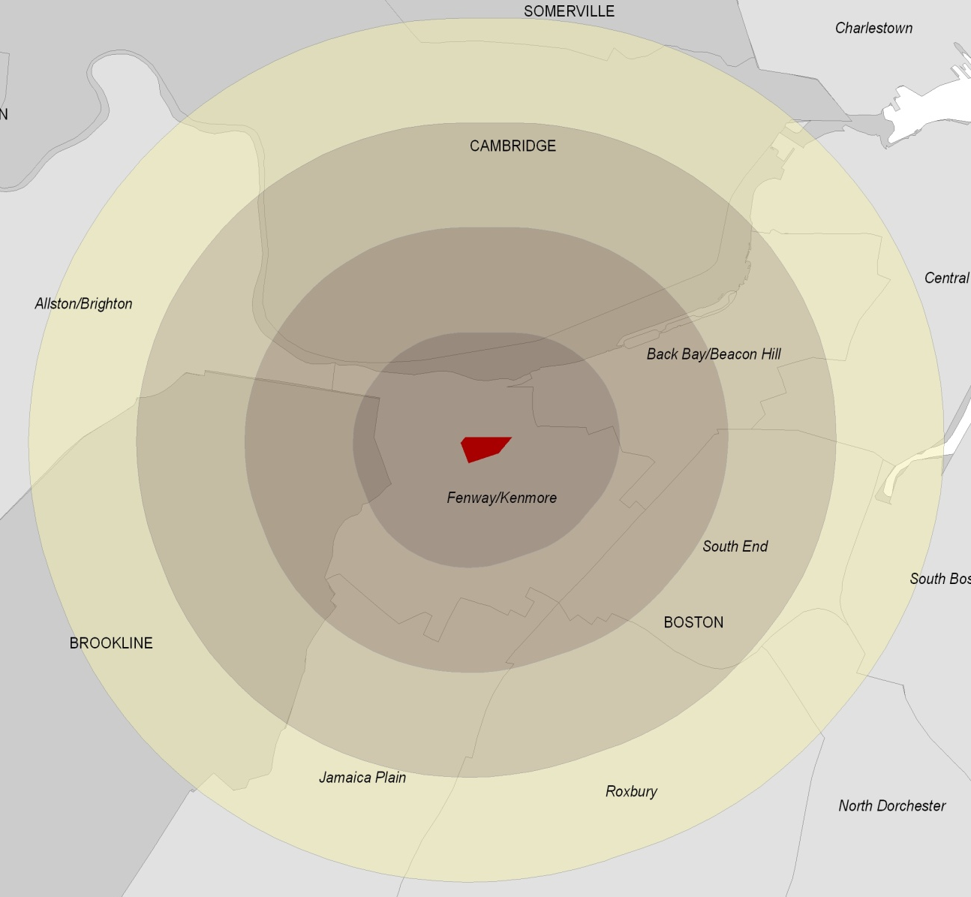
Conduct Analyses
Analyze values (Spatial Statistics)
Learn these tools and more in our GIS Level 2 workshop
Create data (Buffer tool)
Edit geometry (Clip tool)
Crime hotspots © Scott & Warmerdam. All rights reserved. This content is excluded from our Creative Commons license. For more information, see https://ocw.mit.edu/help/faq-fair-use/
18
Notes:
GIS has many tools for acting upon datasets:
Some tools act on the geometry (clip), create new data (buffer), or analyze the data values (spatial statistics).

Slide 19
Understanding maps & data
You may have been looking at geospatial data for a long time
19
Notes:
We will explore maps and data is this section of the presentation.

Slide 20

Understanding data ‘layers’
What individual data layers were used to create this map?
© Google. All rights reserved. This content is excluded from our Creative Commons license. For more information, see https://ocw.mit.edu/help/faq-fair-use/
20
Notes:
Google Maps is a type of GIS, really a web mapping tool or geobrowser, and its maps are created from multiple layers of spatial data. As shown previously, a layer is data about a specific set of similar features, such as the location of schools or bicycle paths.
Question: Take a moment to determine what distinct layers are in this map.
Presenter should move on after a few responses come in.

Slide 21
Understanding data ‘layers’
What individual data layers were used to create this map?
T stops with label
Points of
interest
Street network
Bodies of water
Parks and other open space
Google maps is a ‘Geobrowser’
© Google. All rights reserved. This content is excluded from our Creative Commons license. For more information, see https://ocw.mit.edu/help/faq-fair-use/
21
Notes:
Answers: street networks, parks/open spaces, water, T stops, points of interest, etc.
Notes: data are organized by theme: infrastructure, hydrology, administrative boundaries, etc.
-When you create your own maps you can choose which data layers to include and how to visualize them to create a custom map.

Slide 22
Maps & Data: Spatial data types
22

Slide 23
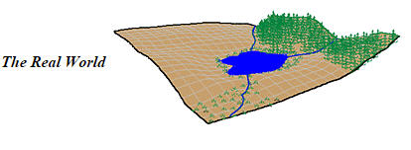
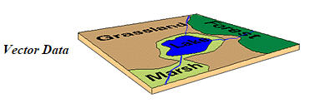
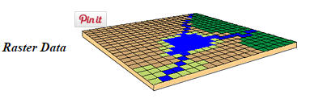
Geospatial Data Types
Geospatial or coordinate data can be represented in two different data formats:
Vector:
e.g. points, lines, and polygons
Raster:
e.g. row and column matrix
Images © University of Washington. All rights reserved. This content is excluded from our Creative Commons license. For more information, see https://ocw.mit.edu/help/faq-fair-use/
23
Notes:
There are two main approaches to representing real world data, vector and raster.
Vector represents the world in points, lines, and polygons, while raster uses rows and columns.

Slide 24
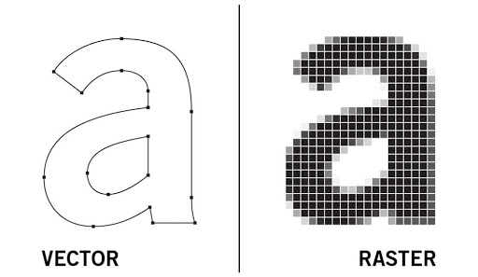
Data Types: Vector versus Raster
Vectors are composed of coordinates
Raster's are composed of pixels
These are often used for variables with:
defined borders, e.g. manmade
continuous surface, e.g. environmental
Image courtesy of Zina Yonten. Used under CC BY-NC.
24
Notes:
In some cases data can be represented as either a vector or raster, but usually certain types of data are better suited for a certain method of representation.
Vectors are composed of coordinates and are best suited to manmade features with defined locations and boundaries.
Rasters are composed of pixels and are best suited to variables, usually environmental, that change over surfaces such as temperature, precipitation, or elevation.
You are able to switch between vector and raster format to use different tools, which you can see in our GIS Level 2 workshop materials.

Slide 25


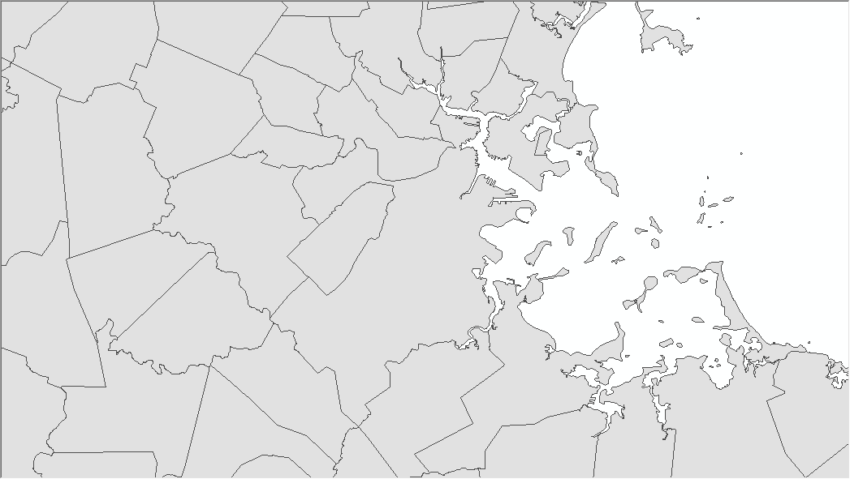
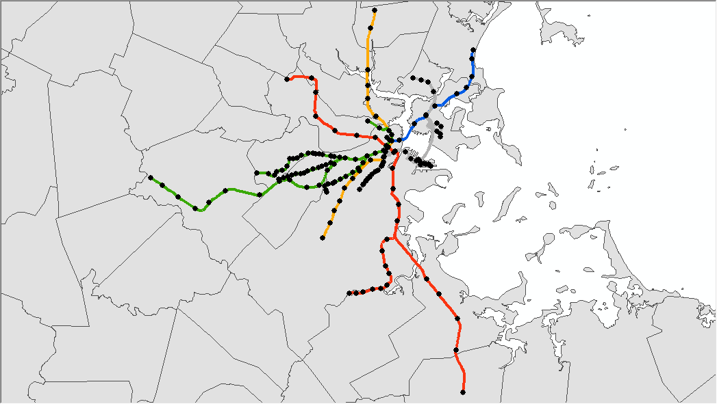
Data Types: Vector examples
Points Lines Polygons (Combined)
25
Notes:
Here you see an example of points, lines, polygons, and all three combined
Question: Can anyone guess based on how these vector layers are color coded, also known as symbolized, what these datasets may represent?
Answer: MBTA Stops, Lines, and Towns, where the lines have been symbolized by color

Slide 26
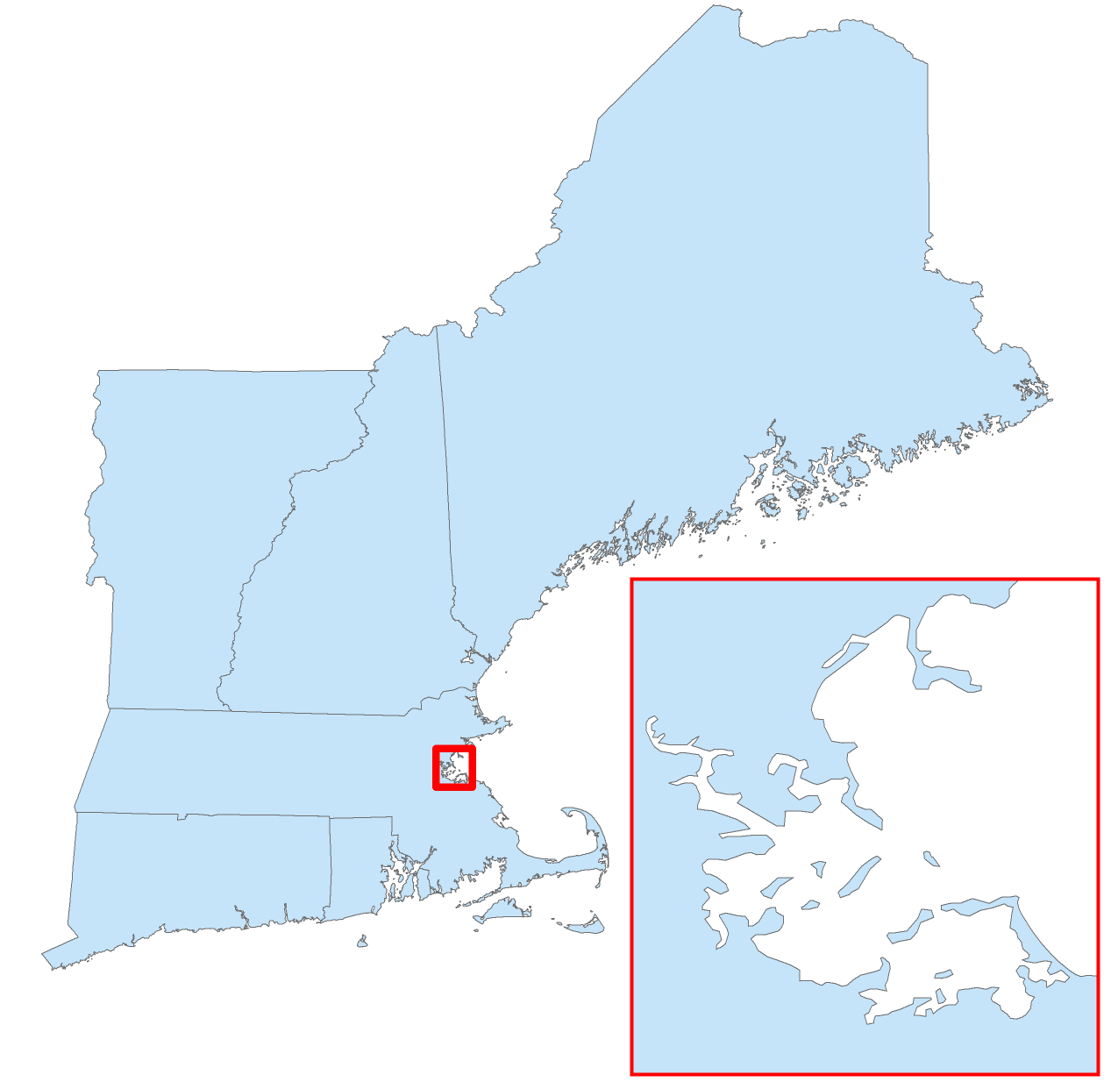
Data Types: Vector mapping
Vectors have a frontend geometry
In this example the geometry represents state polygons
26
Notes:
Geographic data include both a frontend geometry, meaning what you see on the screen in GIS software and a backend database.
Vector data’s frontend geometry is composed of coordinates and displayed as points, lines and polygons. Here is a layer with polygon geometry.

Slide 27
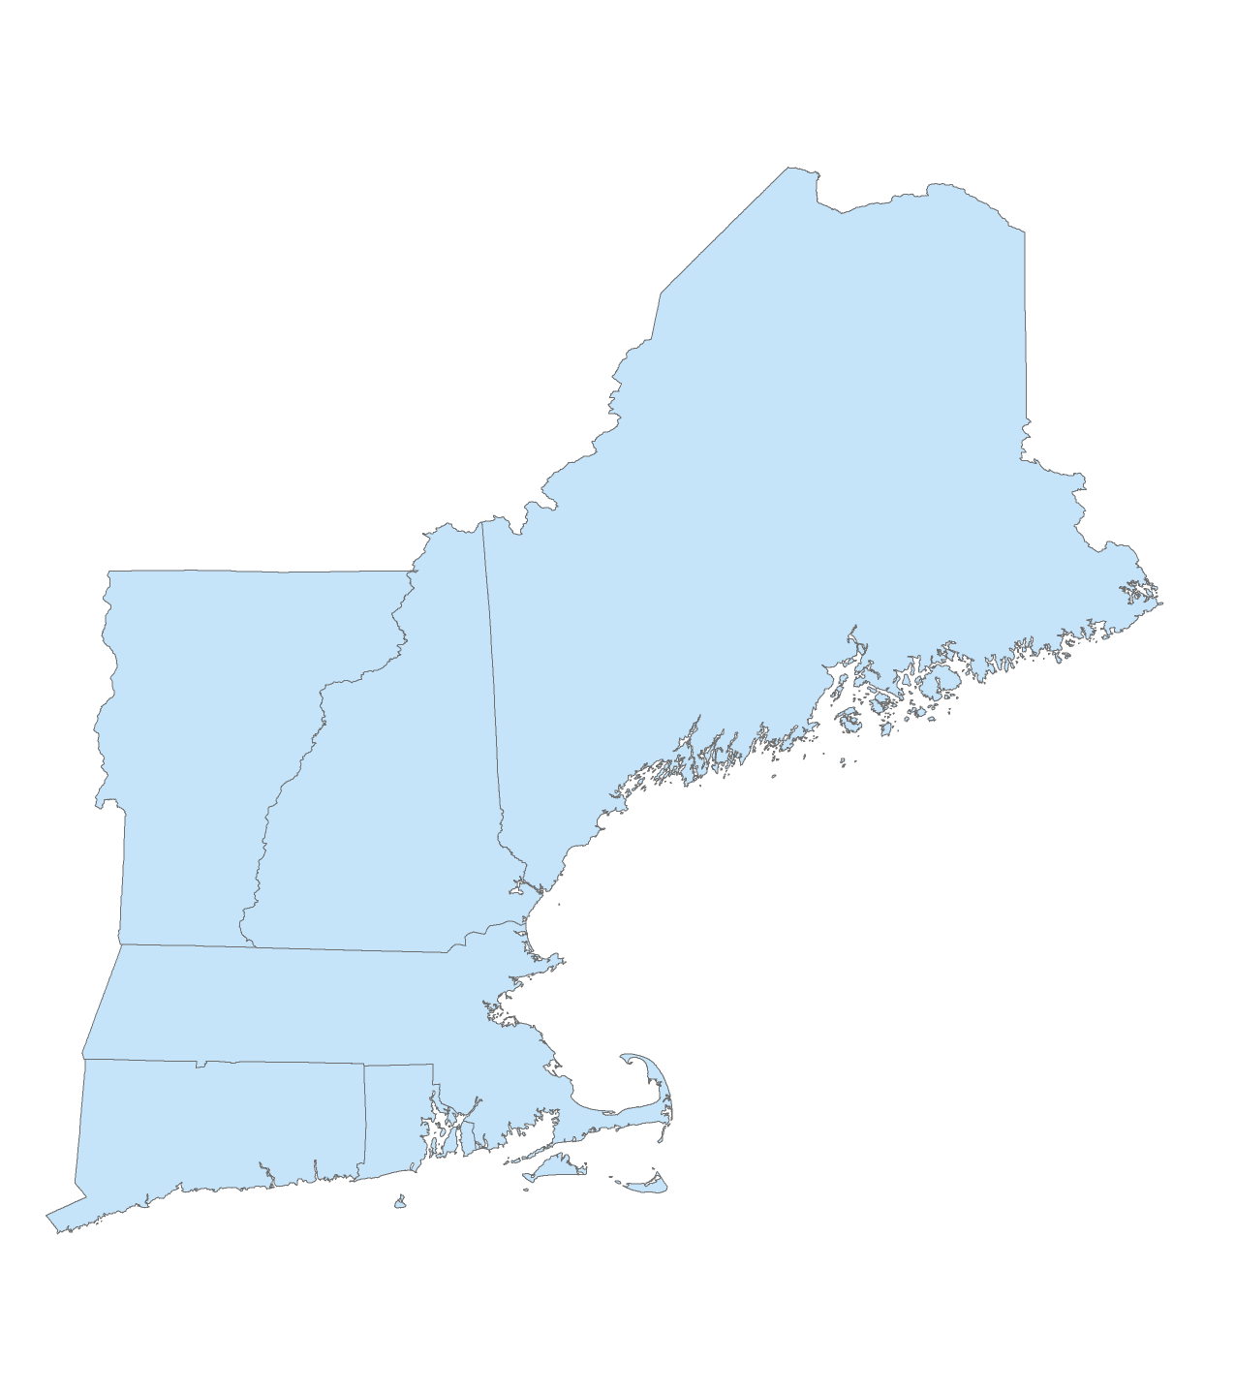
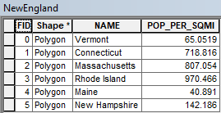
Data Types: Vector mapping
Vectors have a backend database, normally called an ‘attribute table’
rows represent unique geometries (e.g. state polygons)
columns represent a number of variables (theoretically infinite)
Here each row (state) is symbolized by ‘NAME’ (categorical variable)
27
Notes:
The backend database is called an attribute table. Each row is equivalent to one feature on the map. In this example each row represents a different state polygon.
Each column is a different piece of information about that feature. In this example there is information about the state name and the population per square mile.
Vector data can have a large number of columns associated with their geometries, each of which can then be symbolized to produce different maps.

Slide 28
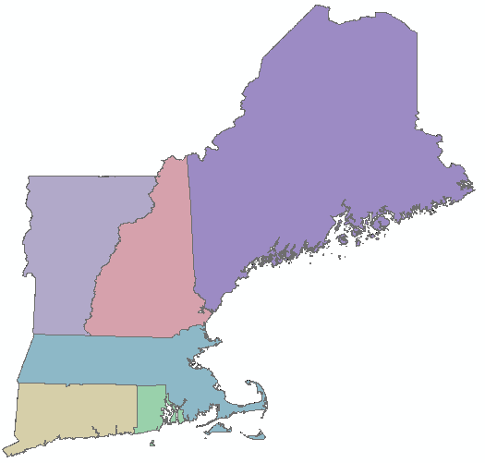
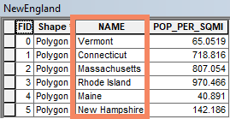
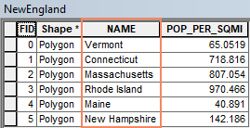
Data Types: Vector mapping
Vectors have a backend database, normally called an ‘attribute table’
Here each state is being symbolized by ‘NAME’ (qualitative variable)
28
Notes:
The map can be symbolized based on any column in the attribute table, meaning the color, size, shape, pattern, etc. of a feature can be changed to correspond to the data in a particular column.
Here the map was color coded based on a qualitative (aka categorical) variable, state name, where each unique state name was symbolized by a different color.

Slide 29
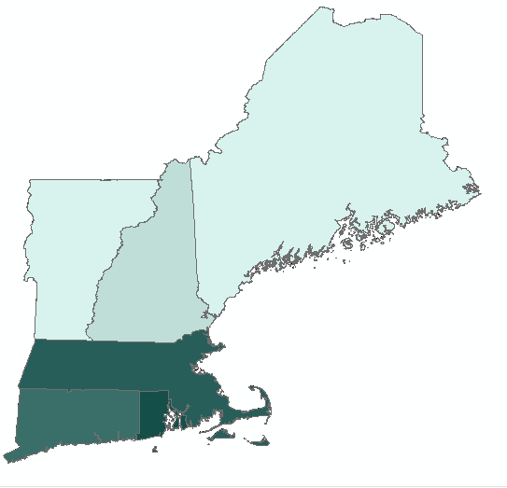
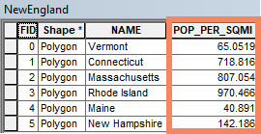
Data Types: Vector mapping
Vectors have a backend database, normally called an ‘attribute table’
Here each state is being symbolized by ‘POP_PER_SQMI’ (quantitative variable)
29
Notes:
Here the map was color coded based on a quantitative (aka numerical) variable, population per square mile, where each class of values was symbolized by a different color. We will talk about classes in depth later in the presentation.

Slide 30
Data Types: Vector file formats
The shapefile is the most common vector file format.
“A” shapefile is actually a collection of several different files with different extensions.
Shapefile =
.shp .shx .sbx
.dbf .prj
When adding files to ArcGIS Pro, you will only see one file, not every extension.
Make sure to keep all files together when moving.
30
Notes:
A shapefile is a open source format for vector data that can be opened in any GIS software.
Shapefiles are often in a zipped (.zip) folder because they include several different files. This folder needs to be unzipped to use in ArcGIS Pro, but files can be imported directly from the .zip folder in QGIS.
The .shp includes the actual geometry of the data, the .dbf includes the attribute table, and the .prj contains the map projection, which is covered more in GIS Level 2. Other files include indexes that speed up the loading and display of the data. Keep these files together when you move or share data in order for them to load properly.

Slide 31
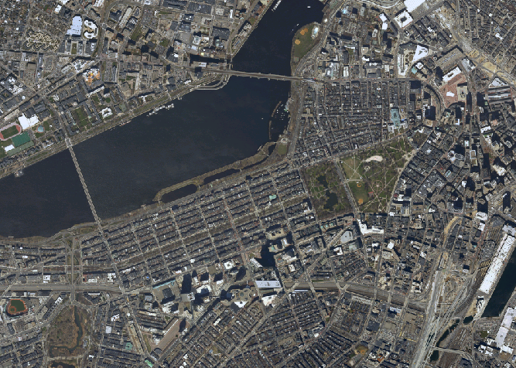
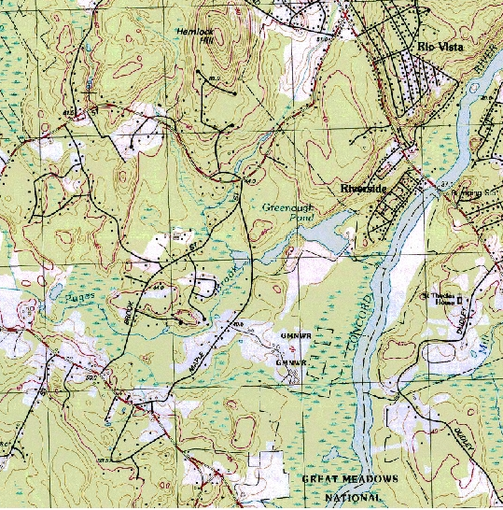
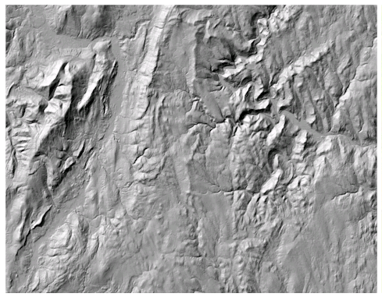
Data Types: Raster
Raster data includes aerial photographs, digital elevation models, and scanned maps.
(Remember these are constructed from pixels)
31
Notes:
Here you see examples of rasters, such as aeriel photographs, digital elevation models, and scanned maps. All of which are constructed from pixels.
Additional Notes:
Early maps were created from surveys and early digital geospatial data were “digitized” from these maps. Data are now created using GPS. Some data are created from aerial photographs. Data are constantly being updated

Slide 32
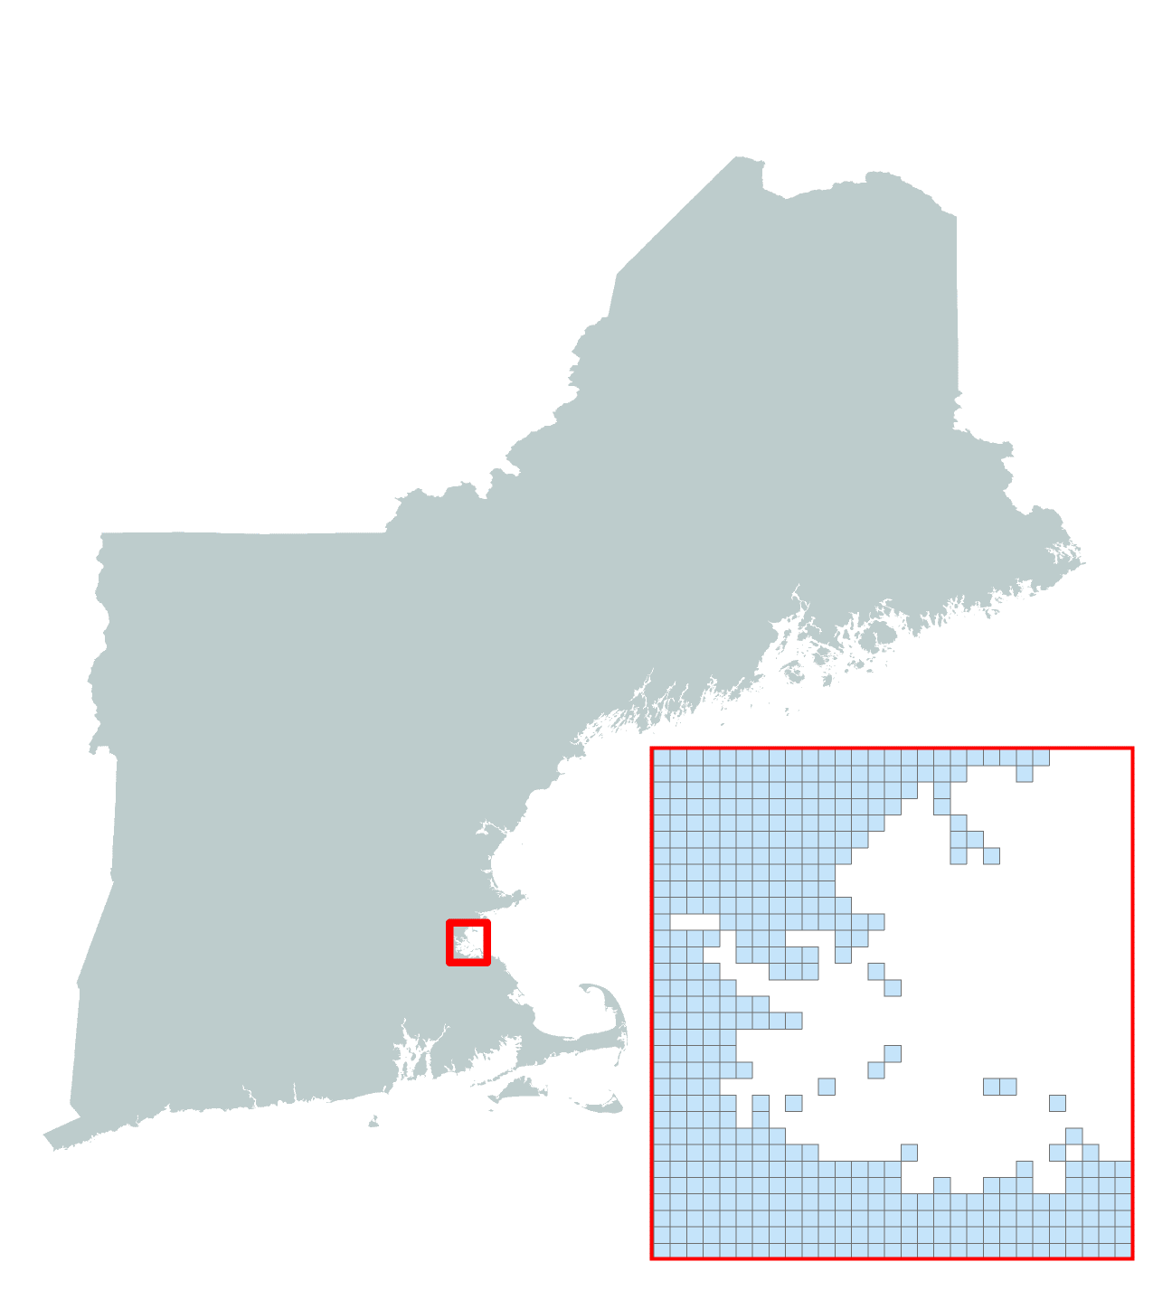
Data Types: Raster mapping
Raster data have a frontend cell matrix
Where each cell has its own value
A raster can only symbolize one variable at a time
32
Notes:
Raster data is a continuous cell matrix. Each cell or pixel is the same size and has its own value.
Rasters can only symbolize one variable at a time due to how its attribute table functions.

Slide 33
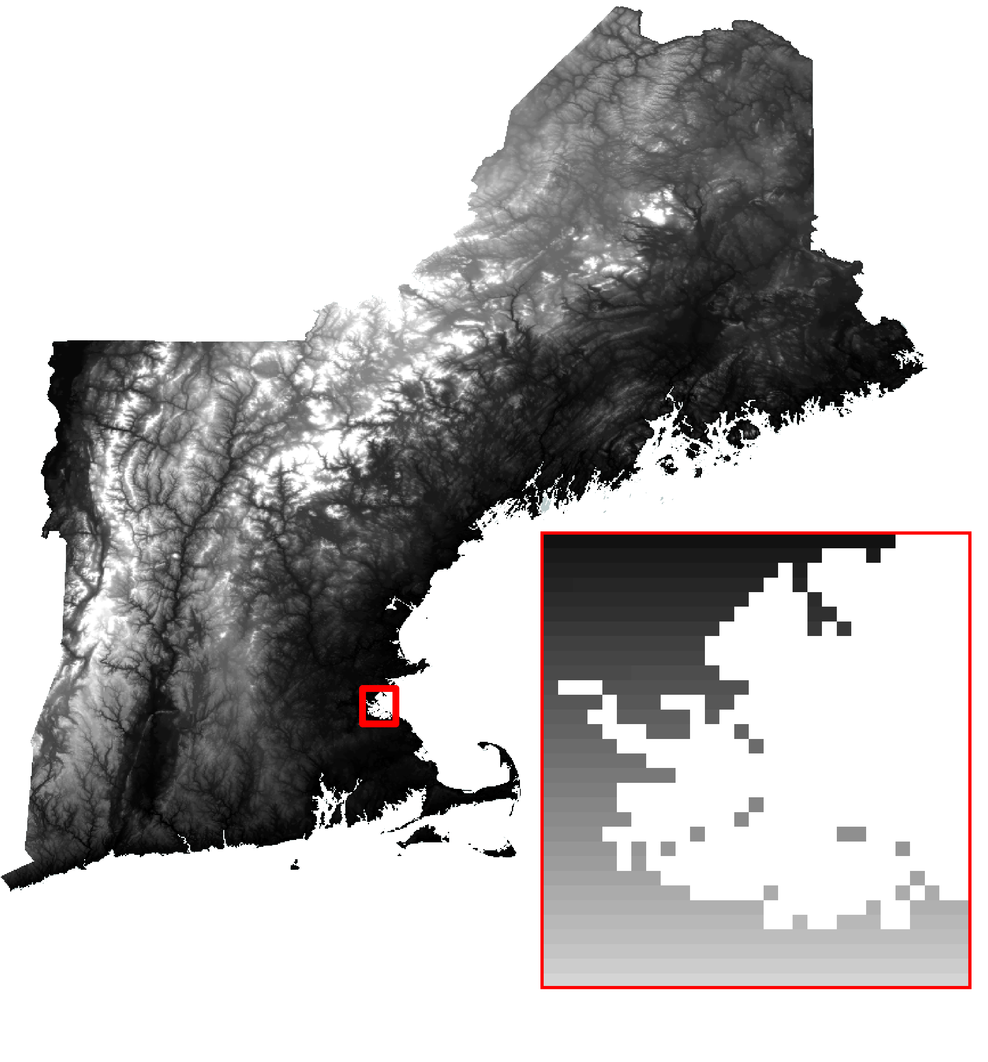
Data Types: Raster mapping
Raster data have a frontend cell matrix
Here each cell/pixel is being symbolized by elevation value
33
Notes:
Here the map is color coded based on a quantitative (aka numerical) variable, elevation, where each unique pixel value is symbolized by a shade of grey stretching from black to white.

Slide 34
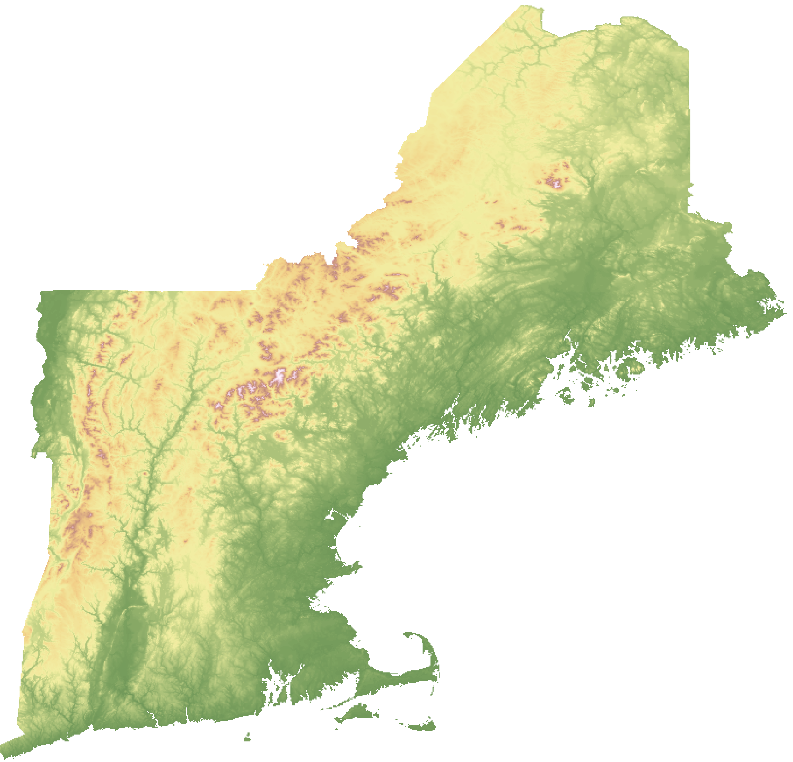
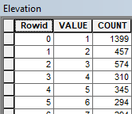
Data Types: Raster mapping
Raster data have a backend database, normally called an ‘attribute table’
rows represent unique values (1m, 2m, 3m, etc.)
columns have specific variables
1) unique ‘ROW ID’
2) unique ‘VALUE’
3) ‘COUNT’ of pixels with that ‘VALUE’
34
Notes:
Raster data have attribute tables with specific properties: a unique id for each cell/pixel, the value of that cell, and the count of other cells with that same value.
Note: the map is the same elevation data symbolized with a different color ramp.

Slide 35
Data Types: Raster file formats
There are many different raster file extensions, including common image formats.
.tiff
.asc
.img
.jpg
Learn more about raster formats in this ArcGIS Pro documentation. QGIS supports similar formats.
Some formats may include a collection of files with different extensions, similar to a shapefile.
35
Notes:
Raster file formats include common image formats and there are many more raster file formats that are not listed here.
There are often associated files that tell the GIS software where to place the raster on the map, similar to how a .prj file works in a shapefile.
If you import an individual image, such as a .jpg of a scanned map, you will need to do what is called “georeferencing” and tell the software how to align it with the rest of your data.

Slide 36

Data Types: Tabular
Tabular data can be transformed
into spatial data in two ways:
1. Joining
Use a shared unique identifier (GEOID, name, etc.) to match up tabular data to the spatial data’s attribute table.
2. Geocoding
Use lat/lon coordinates in table to plot as points on map
Use addresses to plot locations based on a street network
36
Notes:
You can convert tabular data such as those in spreadsheets so long at the data contains certain geospatial information (i.e. shared unique identifiers, lat/lon, and/or addresses). See our GIS Level 2 workshop materials for hands on experience.

Slide 37
Data Types: Tabular file formats
GIS software can read commonly used tabular formats in order to transform them into spatial data.
.csv
.xlsx
.dbf
Shapefiles include a .dbf, which is a tabular format that can be opened in other software, like Excel.
QGIS cannot read Excel file formats.
37
Notes:
GIS software can read common tabular data formats. If there is geographic information included in the data table, GIS tools can be used to transform the table into a shapefile.

Slide 38
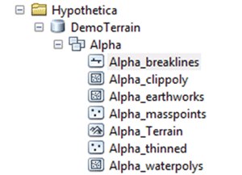
Geodatabases
ESRI/ArcGIS storage system
a collection of geographic datasets of various types held in a common file system folder
Advantages: larger files size limits, faster processing time when using analysis tools
Disadvantages: can only be opened in ESRI software
Learn more about using geodatabases in Pro.
38
Notes:
Geodatabases are a file storage format used in ArcMap and ArcGIS Pro.
Geodatabases are similar to zipped files in that they can store and compress a variety of different data types, including vectors, rasters, and data tables.
They are useful for organizing data and speeding up processing time when working with large files. A disadvantage is that they can only be opened in ESRI software.

Slide 39

Other data formats
GIS can import and convert data produced in other formats:
KML / KMZ files (Google Earth)
DXF / DWG (CAD)
NetCDF (scientific data)
LAS (Lidar)
GPX (GPS units)
Geojson
GIS software can export many formats:
Adobe Illustrator
KML
CAD
TIF
JPG
The GIS & Data Lab has many types of data visualization software.
39
Notes:
GIS software can import and export data in a variety of formats. Some common import formats include KML/KMZ from Google Earth and CAD files. Maps can be exported in image formats for reports or presentations, such as CAD or Illustrator for further development.

Slide 40
Common Associated Workflows
Satellite Remote Sensing
GIS
Processed imagery as rasters or vectors (e.g. enhancements, classifications)
Raw Imagery for basemaps
3D Modeling & Photogrammetry
Processed imagery as rasters or models (e.g. orthophotos, DEMS, 3D models)
Statistical Analysis
Attribute tables for running analyses, (e.g. regressions, predictions)
Visual Design (e.g. Illustrator)
Maps for improved design aesthetics
40
Notes:
Many people do not just need GIS software to conduct their research.
The ability to import and export data and maps allows you to work in a variety of software before or after using GIS.
Common workflows include using GIS in conjunction with remote sensing software, which is used to analyze satellite imagery, with 3D modeling software such as CAD or Rhino, using attribute tables in statistical analysis software, and creating elaborate maps designs with visual design software.

Slide 41
Exercise 1
Goals:
Become familiar with the GIS interface
Learn how to add data
Explore data types & attributes
Complete either the QGIS or ArcGIS Pro exercise from your workshop folder.
41

Slide 42
Maps & Data: Characteristics of spatial data
42

Slide 43
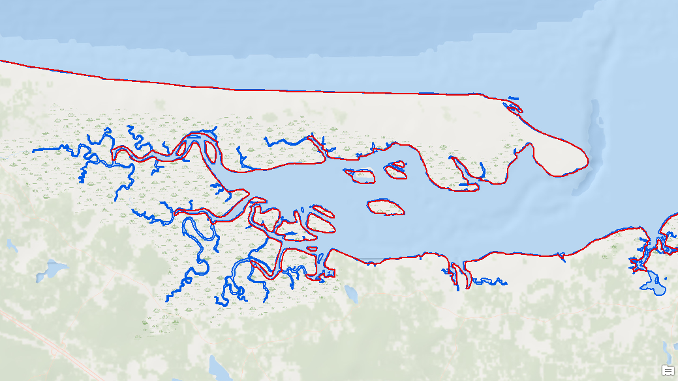
Generalization
The most detailed data available is not suitable for all purposes (or often a manageable file size)
e.g. resolution of coastline data for this map is scale dependent
Red: county map
Blue: town map
43
Notes:
There are characteristics of spatial data that make it unique from other types of data. You need to know about these special features in order to find and use spatial data.
Spatial data is generalized, meaning it is simplified from what you would find in real life. The more detailed your data are, the larger the files sizes, which means more data to store and longer processing times when analyzing it in GIS software.
Depending on your project, you may need data with more or less detail. In this example, the coastline outlined in red would be suitable for display on a county or state map. It would be difficult to see a lot of the small inlets and islands at that scale so you want something more generalized, with less detail.
The coastline outlined in blue would be suitable for a map of the town or something smaller, such as a specific bay or beach. More detail is often useful when mapping or analyzing a small area.

Slide 44


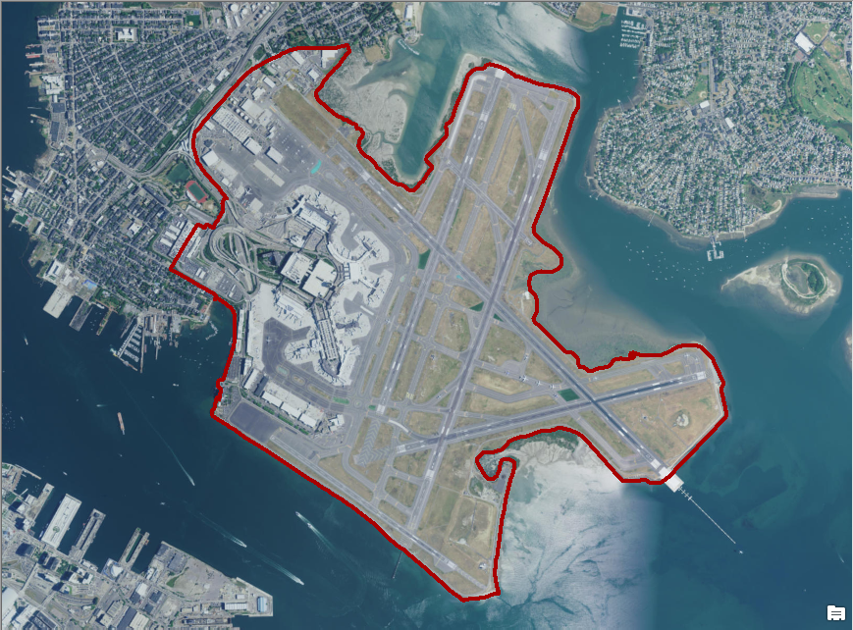
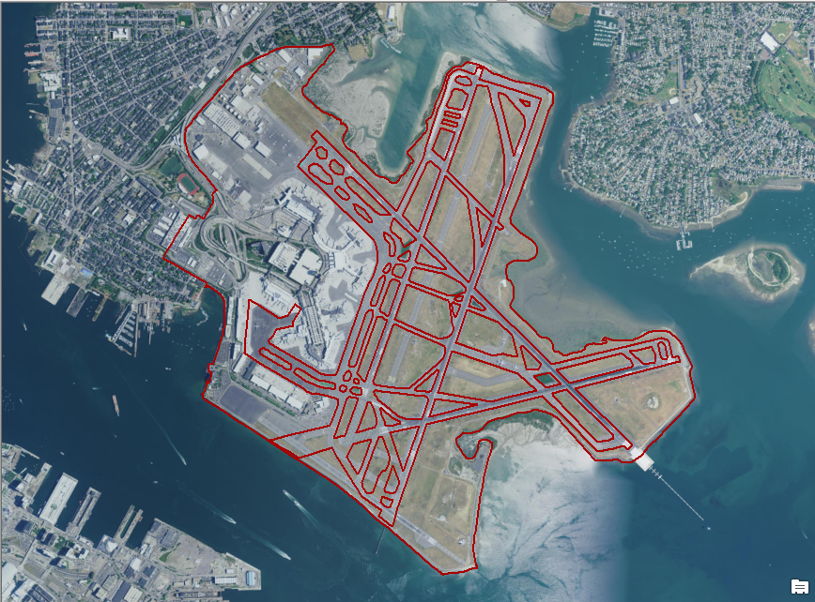
Abstraction
The process of reducing data from its complete state to what is necessary for use and presentation
A
B
C
D
Quiz: Which data symbology (pictured above) would you select for each of the following maps?
Land use study of adjacent property
Development map of the airport
National map of airports
44
Notes:
Spatial data are also abstracted, meaning they include only what is necessary for your map and analysis. It would be impossible to include every feature that you see in real life on a map. Not only would it create large files, but the map would be difficult to read.
This example includes data that have been abstracted in different ways, for different purposes.
Example A is satellite imagery of an airport without any additional symbology.
Example B uses a symbol of an airplane to represent the airport.
Example C uses a polygon to represent the border of the airport property.
Example D uses polygons and lines to represent the airport border and the runways.
Which data symbology would you select if you wanted to do a land use study of properties adjacent to the airport?
C - Because it shows the border, you can easily see what is adjacent. Example D also shows the airport border, but includes runway information, which you do not need.
Which data symbology would you select if you wanted to create a map of potential new develop within the airport? (pause)
D - Because it shows the airport layout. It would be important to know where the runways are when planning future development.
Which data symbology would you select if you wanted to create a map of all airports in a country? (pause)
B - Because it just shows the airport as one symbol. If you used the symbols pictured in C or D, you map would be messy and difficult to read.

Slide 45
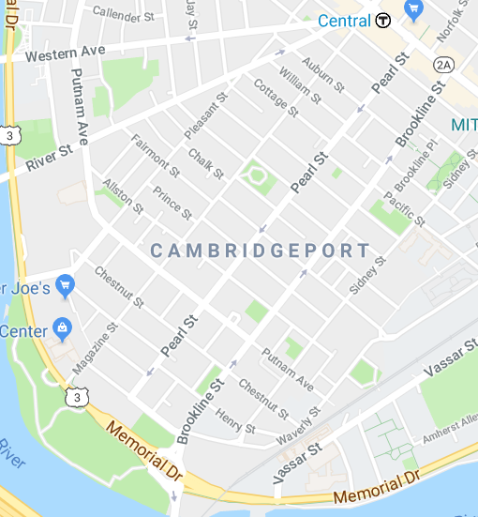
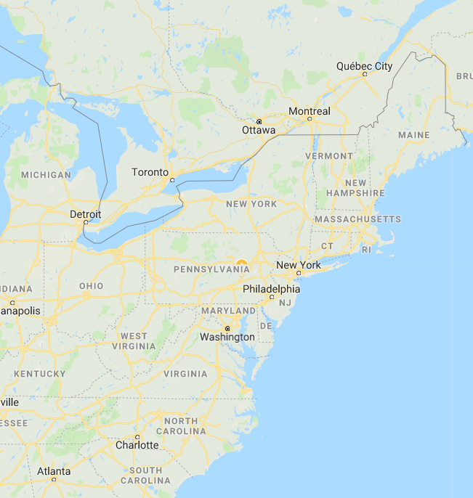
Spatial Resolution/Scale
Suitable data geometry is dependent on scale:
e.g. roads are polygons at local scale but lines at national scale
45
© Google. All rights reserved. This content is excluded from our Creative Commons license. For more information, see https://ocw.mit.edu/help/faq-fair-use/
Notes:
The spatial data you make visible on a map depends on its scale, meaning how small or large of an area you are showing. You should show enough detail at a particular scale so that your viewer can clearly see all the features you have added.
Question: Can you spot any other features dependent on scale?
In the city map on the left, you can see points of interest, street widths, directions and names, and public transportation stops. These are not visible in the regional map on the right because they are not needed at that scale and would make the map impossible to read. The regional map includes points that represent major cities, highways, and larger state and national parks.

Slide 46
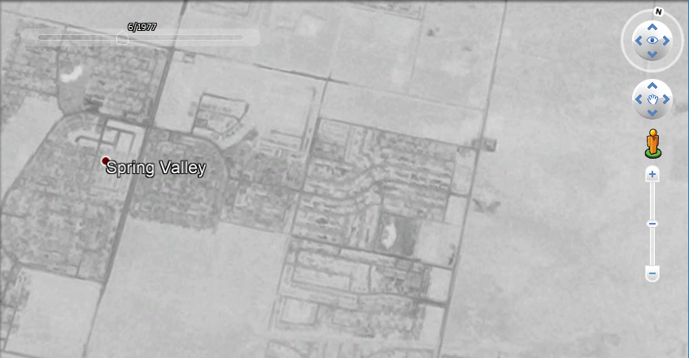
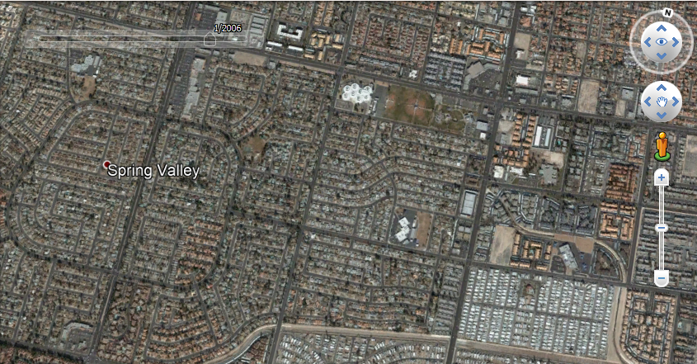
Temporal Resolution
1977 to 2006
Keep in mind temporal resolution when obtaining data
© Google. All rights reserved. This content is excluded from our Creative Commons license. For more information, see https://ocw.mit.edu/help/faq-fair-use/
46
Notes:
Spatial data changes over time. The data pictured on the previous slides are only accurate for that particular point in time. Coastlines may erode or be created in a storm. An airport could expand or close. The names of stores or number of streets may change.
In this example, you can see from the imagery that Spring Valley had a lot of development from 1977 to 2006. Data for roads or houses will look different at different points in time.
Note: These aerial images are from the Google Earth Historical Imagery Time Slider.

Slide 47
Searching for Spatial Data
Look in general GIS data repositories
Search the internet
Include “gis”, or “data” in the search terms
Search by location and/or topic
Search for country statistical agencies or open data sites (large cities often have their own open data portals as well)
Contact GIS departments, universities, or researchers in your area of interest.
Search for articles on your topic and look for the sources of the data.
Great slide to refer back to when starting a project
47
Notes:
Now that you know what type of spatial data to look for, where can you find it?
A lot of data is available freely online, especially for the US.
These are tips you can use in the future for data searches.

Slide 48
Repositories and Websites
Libguides.mit.edu/gis
Can also find by googling ‘MIT GIS’, first result
Click on Find Data Tab for a list of resources, including an assembled links of common data sources per topic.
Geodata.mit.edu (Geoweb)
Includes data licensed freely or restricted to MIT and other institutions, plus CDs and DVDs in the GIS lab.
MIT instance is mainly historical-local or purchased data.
OpenStreetMap.org
Crowd-sourced maps; content will vary by location
Download as a shapefile via http://www.geofabrik.de/
Best source to start for rural international data.
Find many more on our website.
48
Notes:
Here we’ve listed 3 of the data repositories we frequently use when assisting researchers.
At the top is the MIT Libraries GIS research guide which you can find by simply Googling MIT GIS. If you hover over the Find Data tab, you’ll see a breakdown of GIS data sources by geography and subject.
MIT also has a resource called Geoweb which includes freely available data as well as licensed data restricted to MIT and other universities. The data restricted to use by MIT community members consists largely of data purchased by the GIS team on specific topics or areas of the world.
OpenStreet Map is an open repository of crowd sourced maps. The amount of GIS data will vary by location.

Slide 49
Maps & Data: Metadata
49
Notes:
Now we will talk about metadata, aka information about our data.

Slide 50
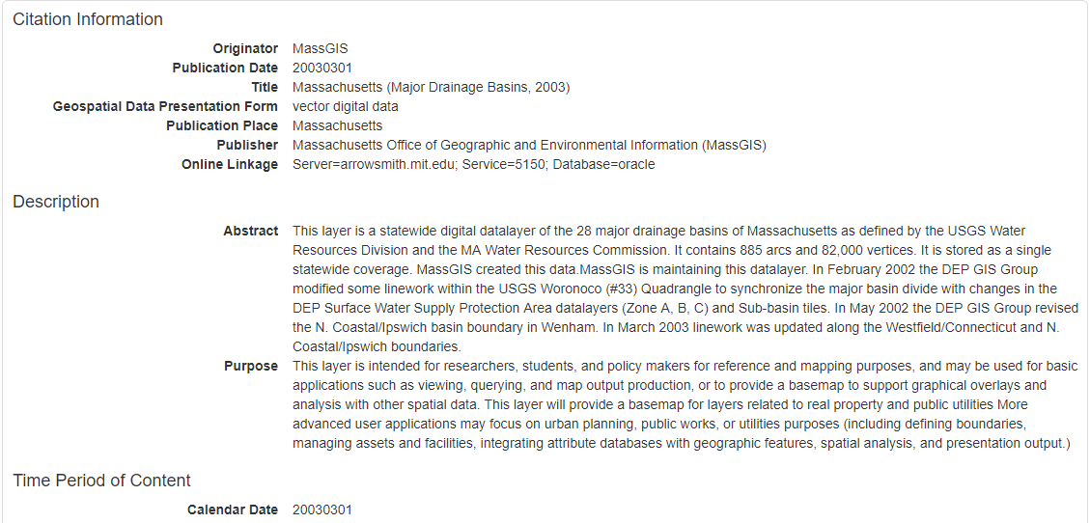
What is Metadata?
Use metadata to learn how and why the data were created, access restrictions, columns in the attribute table, and much more!
50
Notes:
Metadata is a way of describing an information resource so you can better understand the data. It often describes how and why a dataset was created as well as provides information about any codes used within the dataset.

Slide 51
Metadata Examples
MassGIS:
https://www.mass.gov/info-details/massgis-data-marine-beaches
GeoWeb: geodata.mit.edu/catalog/mit-w37ehgh6nvl4w
City of Boston: https://data.boston.gov/dataset/traffic-signals
51
Notes:
Shown here are some common metadata sources for geospatial repositories around Boston. Let’s go through each link and see how their metadata are represented differently.

Slide 52
Making Great Maps: Data Visualization Principles
52
Notes:
Let’s talk about some data visualization principles for making great maps.

Slide 53
Making Great Maps
Cartography is the art and science of making maps
Maps are always simplifications of reality, which makes them helpful when making decisions or explaining patterns
Maps are designed by people (who have intentions), so we have to create them responsibly
53
Notes:
Art & science = design & analysis
Simplifications of reality = you can’t show everything
Designed by people = there’s a motive behind their creation

Slide 54
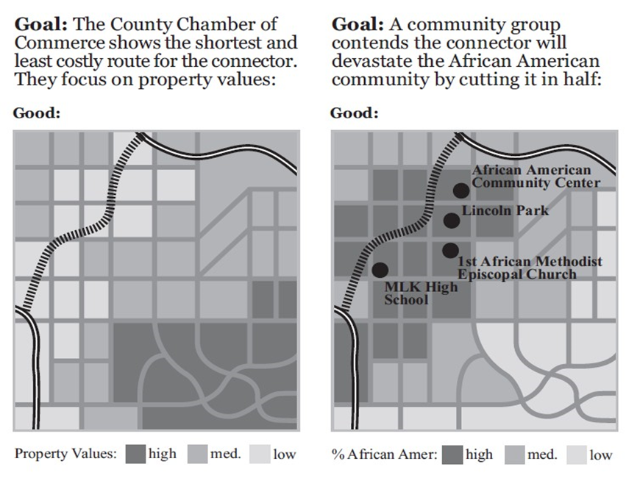
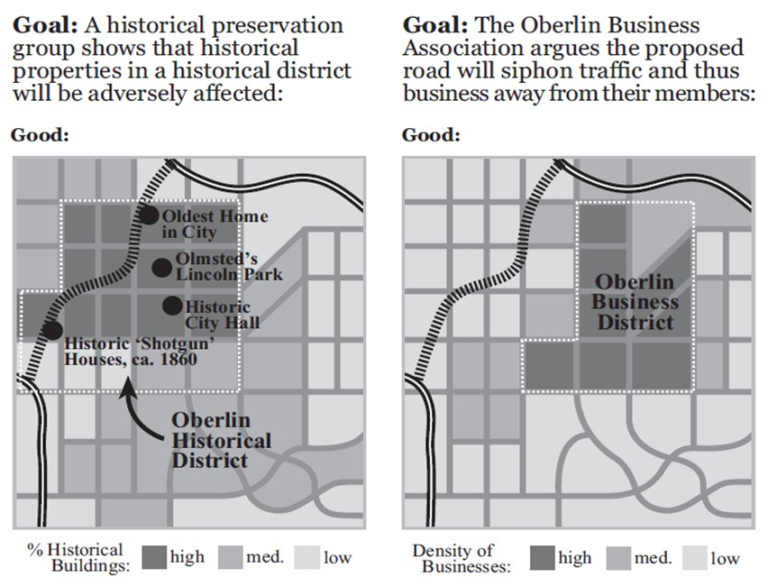
Making Great Maps
From: Making Maps: A Visual Guide to Map Design for GIS by John Krygier and Denis Wood
Example of how a map can be used to prove many different points. However in the past only those in power had the software and data to do so.
Images © John Krygier and Denis Wood. All rights reserved. This content is excluded from our Creative Commons license. For more information, see https://ocw.mit.edu/help/faq-fair-use/
54
Notes:
In this example, we see successive maps all using similar symbology but different variables to argue the location a highway connector should be placed. Things to keep in mind are:
-only relevant features (for a particular group) were selected to be in each map.
-each map is by a different creator and trying to convey a different message
-each map is good for a different group
Question: which is best, and what they think the solution should be?
Answer: (all correct, but all biased)

Slide 55
Three Key Questions
Who wants the map?
e.g. experts (detailed), students (contextual), the community (interactive)
Where will it be seen?
e.g. 8x11 paper (static small, room for main points)
e.g. 30x40 poster board (static large, room for detail)
e.g. web map (interactive, users control navigation of map)
What is it’s purpose?
e.g. to show a variable through time (time series)
e.g. to show change over time (change detection)
e.g. to combine multiple variable into an index to pick best/worst (sustainability/risk/vulnerability mapping, site selection)
Each question deserves a well-thought answer before mapping
55
Notes:
You also want to keep in mind some key questions, such as who wants the map and where it will be seen, both of which will affect the level of detail and whether or not the map should be interactive.
Depending on the purpose for the map will affect what type you will create, such as change through time vs. space, and/or combining multiple variables for decision making.

Slide 56
Map Design Process
Figure 5.3
Start with assembling the data from multiple sources
Next choose the data, analyses, & symbolization
Lastly insert the title, legend, north arrow, scale bar, & labels
56
Notes:
Stage 1: collecting your data (we talked about this at the beginning of the workshop)
Stage 2: symbolize your data (we will talk about the next 2 items now)
Stage 3: create a layout (add title, scale bar, legend, north arrow, etc.)

Slide 57
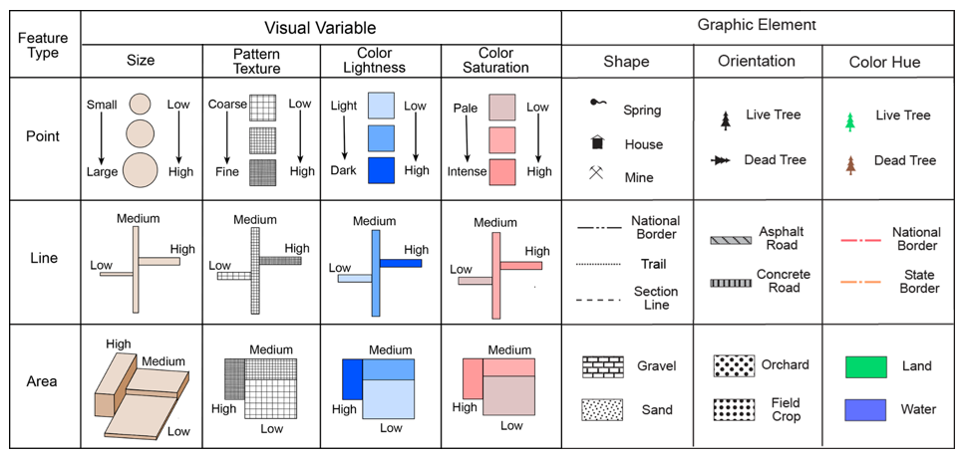
Vector Symbolization
From: Making Maps: A Visual Guide to Map Design for GIS by John Krygier and Denis Wood - makingmaps.owu.edu
Colorbrewer provides accessible color options.
Images © John Krygier and Denis Wood. All rights reserved. This content is excluded from our Creative Commons license. For more information, see https://ocw.mit.edu/help/faq-fair-use/
57
Notes:
There are many ways to symbolize vector data as points, lines, and polygons. While color is one of the more common ways to symbolize data, this chart shows additional ways to show differences among features on your map by varying size, pattern, shape and orientation.
When choosing any type of symbology, it is important to think about accessibility, especially in relation to color blindness. The Colorbrewer website allows you to filter colors based on those that can be viewed by people with color-blindness. ArcGIS Pro also has this option in its symbology menu.

Slide 58
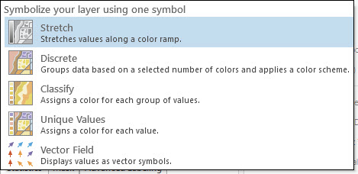
Raster Symbolization
58
Notes:
Raster data are symbolized differently from vector data, as you saw in the earlier modules about types of spatial data, because they are continuous surfaces. Raster data can be displayed by showing all data values, grouping values into categories, varying colors across the surface based on the value, or creating a vector field using symbols, which you might see in a map of wind direction and speed.

Slide 59
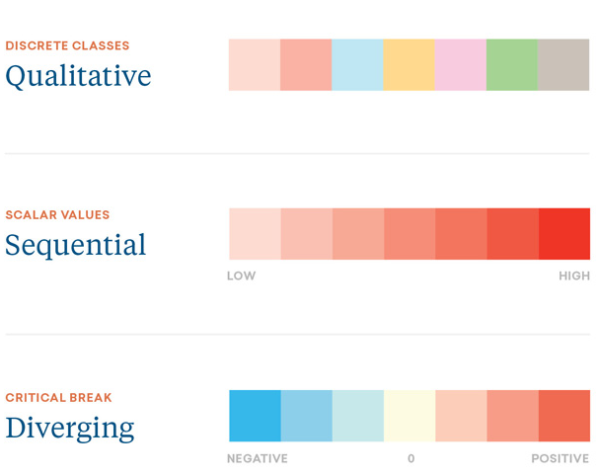
Choosing Color Tips
Match the type of data to the type of color scheme:
Qualitative (categories)
Quantitative (numbers)
Images © Morphocode. All rights reserved. This content is excluded from our Creative Commons license. For more information, see https://ocw.mit.edu/help/faq-fair-use/
59
Notes:
When it comes to choosing color, you want to be mindful of they type of data you are working with. Qualitative data often uses different colors for each category, while quantitative data often uses one color or two if there is a diverging phenomena.
Examples of each would be:
Example of qualitative/categorical: land use
Example of sequential numbers: population
Example of diverging numbers: weather/political (e.g. red, blue, neutral)

Slide 60
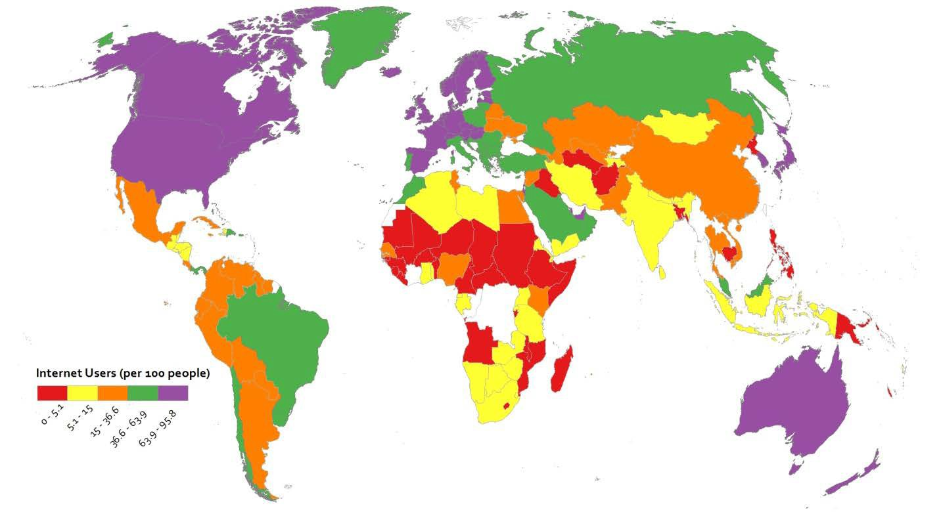

Qualitative Color Example
Does this make sense for the data?
© Pennsylvania State University. All rights reserved. This content is excluded from our Creative Commons license. For more information, see https://ocw.mit.edu/help/faq-fair-use/
60
Notes:
Let’s test our knowledge. In this example we have the variable “Internet Users (per 100 people)”.
Question: Can you tell where the highest internet users are?
Answer: No, doesn’t make sense with quantitative (numerical) data.

Slide 61
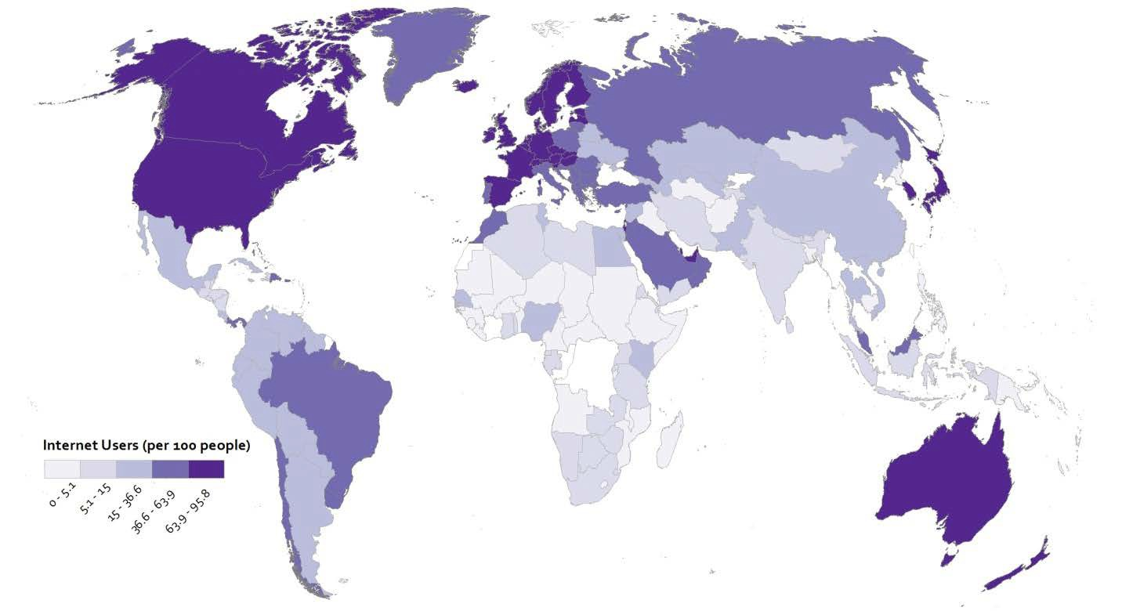

Sequential Color Example
Does this make sense for the data?
© Pennsylvania State University. All rights reserved. This content is excluded from our Creative Commons license. For more information, see https://ocw.mit.edu/help/faq-fair-use/
61
Notes:
Question: Can you tell where the highest internet users are?
Answer: Yes, this has an ascending trend which is reflected in the darker color indicating greater intensity.

Slide 62
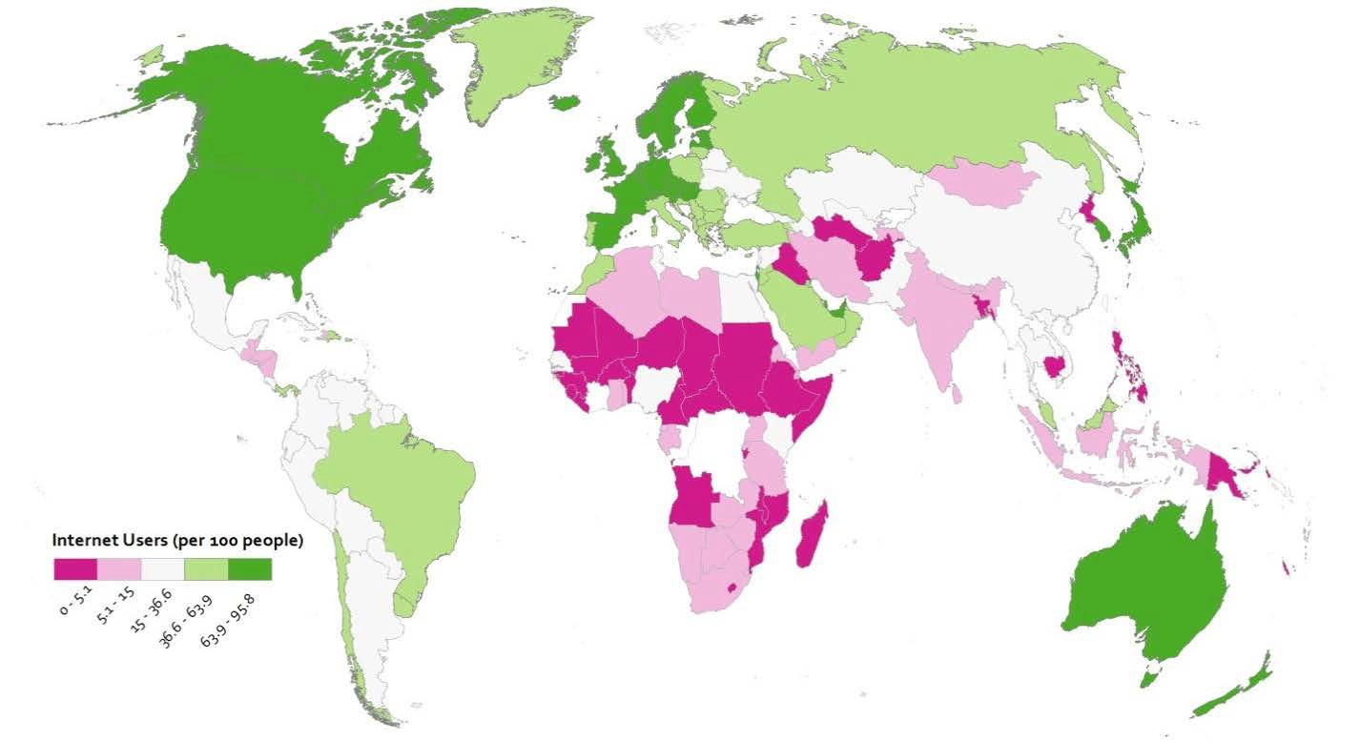

Diverging Color Example
Does this make sense for the data?
© Pennsylvania State University. All rights reserved. This content is excluded from our Creative Commons license. For more information, see https://ocw.mit.edu/help/faq-fair-use/
62
Notes:
Question: Can you tell where the highest internet users are?
Answer: It depends. Potentially, this would make sense if there was a certain phenomena that occurred and you wanted to show above/below this value (white colored area).

Slide 63
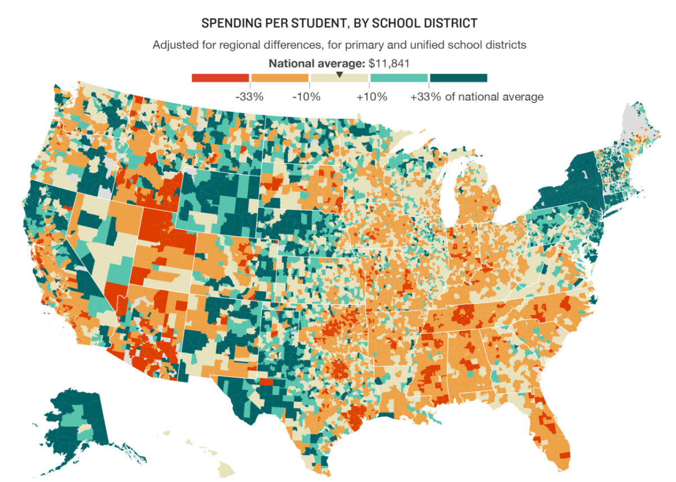
Commonly used map type: Choropleth
These use different shading and coloring to display the quantity or value in defined areas.
© Alyson Hurt and Katie Park/NPR. All rights reserved. This content is excluded from our Creative Commons license. For more information, see https://ocw.mit.edu/help/faq-fair-use/
63
Notes:
One of the most commonly used types of maps is a choropleth map. Choropleth maps use different shading and colors to display the quantity or value in defined areas. Choropleth maps are best used with polygon data so that it’s easier to see color variations.
This example of a choropleth map uses shades of 2 different colors, orange and teal, to show spending per student by school districts. School district is the defined area and spending per student the quantity.

Slide 64


Choropleth map choices
1. Number of Classes
2. Classification Method
Aggregates data for display
More classes = more variation (best to have no more than 7)
Data classification is how data is arranged into separate classes.
Major types
Equal Intervals
Quantile (Equal Count)
Natural Breaks
Defined Intervals
64
Notes:
When designing a choropleth map, you have to make 2 basic choices:
-the number of classes you want your quantity value divided into
-the classification method for arranging the data into those classes
When choosing the number of classes, keep these points in mind:
-the more classes, the more variation you have . The human eye can’t distinguish between large numbers of variations of the same color. It is best to have no more than 7 variations.
-the major types of classification method are Equal Intervals, Quantile, Natural Breaks and Defined Intervals.

Slide 65
Classification Methods
Equal Interval = classes have equal ranges
Quantile = classes have equal counts
Natural Breaks = optimizes class variation
Manual = you define classes
Note: each has pros/cons to their usage, for “Choropleth Classification Methods” use this link: https://libguides.mit.edu/gis/tutorials#s-lg-box-wrapper-4119325
65
Notes:
equal interval classification classes have equal ranges : ranges such as 1-5, 5-10, 10-15
quantile classification, classes have equal counts.: 5 items in each class
Natural breaks optimizes class variation: the algorithm figures out where the breaks should be
manual classification, the user sets the breaks based on prior knowledge of the data

Slide 66






2020 % population over 65
Natural breaks
Quantile
Equal interval
66
Notes:
It’s ok that you can’t see the exact numbers where the breaks are. The important thing is that these maps all use the same data (see histograms), but look different depending on the classification method used (see the amount of each color based on breaks in histograms).
Data source: SimplyAnalytics

Slide 67
Exercise 2
Goal:
Learn how to symbolize different types of data
Complete Exercise 2 for either QGIS or ArcGIS Pro.
67

Slide 68

Map Layout Design Example
Overview:
Map layout design is about developing a balanced arrangement
Maps, title, legend, scale bar, labels, etc. all need relative positioning & sizing
Goal is to design the map layout to support your design questions
Who wants the map
Where will it be seen
What is its purpose
From: Designing Better Maps: A Guide for GIS Users by Cynthia A. Brewer
Image © Cynthia A. Brewer. All rights reserved. This content is excluded from our Creative Commons license. For more information, see https://ocw.mit.edu/help/faq-fair-use/
68
Notes:
Once you have collected and symbolized your data, you are ready to create a layout for your map.
In this example, the eye tends to be drawn more to the legend and highlighted area than to the main map.

Slide 69

Map Layout Design Example
Tips:
Inset/locator maps are often placed in the top/bottom corners (e.g. continent view top left and zoomed view in bottom right).
Main map often placed in center (usually largest & most detailed).
Legend is tucked into the main map for easy comparison with the data.
Scale bars and north arrows shouldn’t be a distraction from the main map.
Sources should run along the bottom.
Complete the take-home exercise to learn more.
From: Designing Better Maps: A Guide for GIS Users by Cynthia A. Brewer
Image © Cynthia A. Brewer. All rights reserved. This content is excluded from our Creative Commons license. For more information, see https://ocw.mit.edu/help/faq-fair-use/
69
Notes:
In this rearranged map we have a much nicer visual flow, where the main map takes up the majority of the frame, and inset maps are tucked into the top and bottom corners for context.
Notice how the legend is not far from the main map for easy interpretation and there is room below the map for discussion and source credits.

Slide 70
TAke-Home Exercise
70
Notes:
Complete the take home exercise for either QGIS or ArcGIS Pro.

Slide 71
Exercise Overview
Query and use unemployment and transportation data to create a map that helps you decide where to build a mixed use facility.
Navigate the software interface
Find and add data, including basemaps
Access and explore attribute information
Symbolize data layers, for vector and raster
Select data by attributes and spatial location
Design a simple map for export
71

Slide 72

Boburg, S. (2017, May 31). How Jared Kushner built a luxury skyscraper using loans meant for job-starved areas. Washington Post. Retrieved from
© The Washington Post. All rights reserved. This content is excluded from our Creative Commons license. For more information, see https://ocw.mit.edu/help/faq-fair-use/
72
Notes:
Your exercise is based on data presented in a Washington Post article. The article was about Jared Kushner’s use of maps to get federal funds meant for job starved areas, but many other developers have used maps for persuasion as well. This is a map from the article and it shows where the development was built. Data was left out to justify building in this location. Will you choose the same location? Where should the development really be built? If we have time, we’ll look at some maps that you have created at the end of the workshop.

Slide 73
MIT OpenCourseWare https://ocw.mit.edu
RES.STR-001 Geographic Information System (GIS) Tutorial IAP 2022
For information about citing these materials or our Terms of Use, visit: https://ocw.mit.edu/terms
73

